Slide 1
Quality Management and Job Quality: How the ISO 9001 Standard for Quality Management Systems Affects Employees and Employers
2022-23925 Syalianda Salsabila Izzati
2022-25172 Lee Sooin

Slide 2

What is ISO 9001?
A set of standards thaT helps organizations ensure they meet customer and other stakeholder needs within regulatory requirements related to a product or service

Slide 3
Controversy upon implementing ISO 9001
Pros
Cons
ISO 9001 improve management practices and production process
Customer recognize ISO 9001 as signal of high-quality
ISO 9001 can improve worker safety by institutionalization of audits
ISO 9001 negatively affect employees, such as by reducing skill requirements or increasing trauma disorders
ISO 9001 does not decrease average injury costs

Slide 4
Research Question
To identify causal effects of ISO 9001 adoption for employees and employers

Slide 5
Literature Review
Organizational Outcome
Employee Outcome
ISO 9001 adopters production growth increased (Terlaak and King, 2006)
Benefits of adopting ISO 9001 is found to be stronger in smaller firms or early adopters (Docking and Dowen, 1999; McGuire and Dilts, 2008)
Adopting ISO 9001 enhances workers productivity (Naves and Erez, 2006)
Not much prior research
Quality programs affect occupational health and safety improvements (Adler et al. 1997)
Adopters of ISO 9001 reduced their accident rates more quickly after certification (Naveh and Marchus, 2007)

Slide 6
Hypotheses OVERVIEW
1A: ISO 9001 certification leads to higher rates of firm survival.
1B. ISO 9001 certification leads to higher sales.
2A: ISO 9001 certification leads to higher employment, but by less than sales increases.
2B: ISO 9001 certification leads to higher labor productivity.
3: ISO 9001 certification leads to higher wages.
3’: ISO 9001 certification leads to lower wages.
4: Adopting ISO 9001 reduces the number and cost of occupational injuries
4’. Adopting ISO 9001 increases the number and cost of occupational injuries.

Slide 7
Hypotheses 1
1A: ISO 9001 certification leads to higher rates of firm survival.
ISO 9001 certification is more often profitable for higher-quality firms, ISO 9001 can signal to buyers that adopters likely possess high quality
ISO 9001 adoption can also help managers learn how to reduce costs.
1B: ISO 9001 certification leads to higher sales.
High-quality firms are more likely to adopt ISO 9001
Standard improves adopter’s quality and cost.

Slide 8
Hypotheses 2
2A: ISO 9001 certification leads to higher employment, but by less than sales increases.
Increase in revenues is due to increased unit sales and demand for additional units cannot be accommodated by existing worker capacity
2B: ISO 9001 certification leads to higher labor productivity
Suggested by survey data, ISO 9001 can also enhance worker productivity (Naveh and Erez 2006)
Still, employment growth will be proportionately less than sales growth

Slide 9
Hypotheses 3
3: ISO 9001 certification leads to higher wages
Attempts for higher employee involvement led to higher wages (Helper et al., 2002)
Reliance on greater employee efforts and skills can lead firms to pay higher wages (Levine, 1992)
3’: ISO 9001 certification leads to lower wages
The use of written procedure implies routinized workplace, which often associated with reduction in workers skills and bargaining power.

Slide 10
Hypotheses 4
4: Adopting ISO 9001 reduces the number and cost of occupational injuries.
ISO 9001 can improve quality, efficiency, and health and safety (King and Lenox, 2001).
Companies are increasingly implementing management systems that incorporate workers health and safety (Toffel, 2000l Barbeau et al., 2004)
4’: Adopting ISO 9001 increases the number and cost of occupational injuries.
Quality management procedures associated with ISO 9001 can occasion poor ergonomic conditions (Landau and Peters, 2006)
ISO 9001 which emphasize routinization and standardization of tasks can increase stress and repetitive motion injuries (Brenner et al., 2004)..

Slide 11
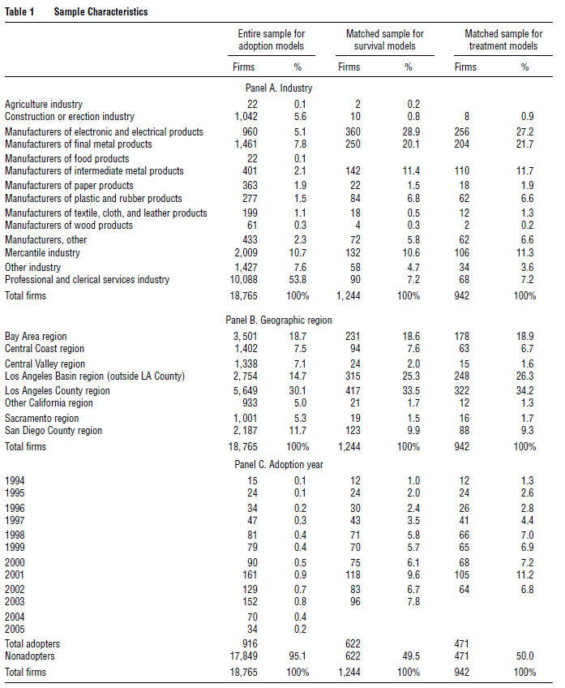
Data
Linking the WCIRB-provided names and address of 116389 data
1079 Adopters & 18480 Non-adopters
Final Sample
916 adopters
17,849 Non-adopters

Slide 12
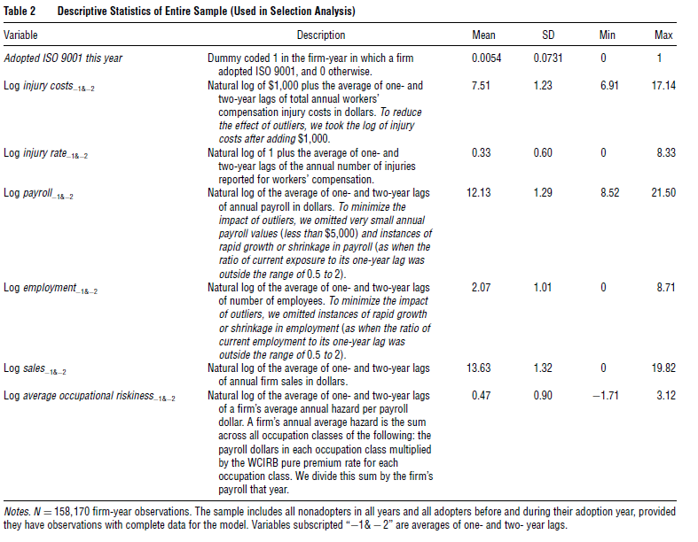
Measures
Dependent variable
Average of lagged level of injury rate, cost, payroll, employment, wages, sales, and average occupational riskiness
Year (Dummy), Industry, region
Exclusion
Payroll off half and twice of previous year
Average wage below $7,200 (Minimum wage of half-time work in CA)
Transformation
Log-formation log(1+x)

Slide 13
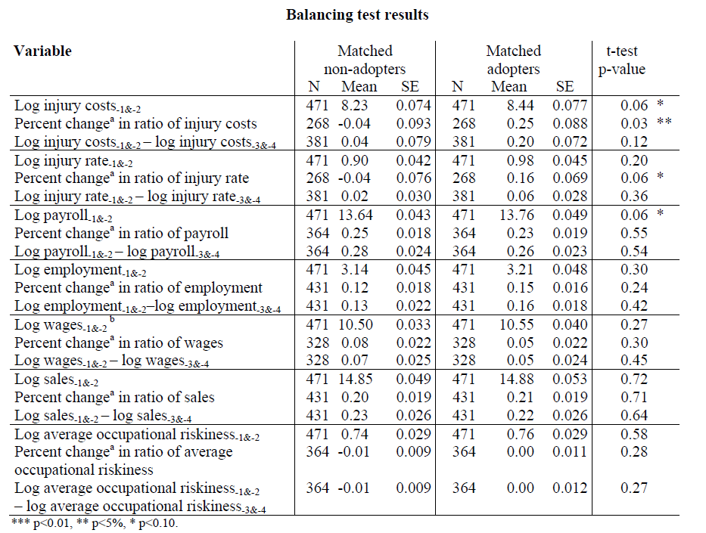
Developing Matched Sample
Industry peers with preadoption
Sales, employment, payroll, injury rate and other observable factors
Single nearest neighbor matching
To classify X into its closest neighbor hood among the training points and assign labels
Second Stage
Drop pairs that exceeded given caliper size (0.07)

